Slide 1
Virtual Memory Lesson 4 Frame Allocation
David Liu
Fall 21, Spring 22

Slide 2
Allocation of Frames
Each process needs minimum number of frames
Example: IBM 370 – 6 pages to handle SS MOVE instruction:
instruction is 6 bytes, might span 2 pages
2 pages to handle from
2 pages to handle to
Maximum of course is total frames in the system
Two major allocation schemes
fixed allocation
priority allocation
Many variations

Slide 3
Fixed Allocation
Equal allocation – For example, if there are 100 frames (after allocating frames for the OS) and 5 processes, give each process 20 frames
Keep some as free frame buffer pool
Proportional allocation – Allocate according to the size of process
Dynamic as degree of multiprogramming, process sizes change

Slide 4
Global vs. Local Allocation
Global replacement – process selects a replacement frame from the set of all frames; one process can take a frame from another
But then process execution time can vary greatly
But greater throughput so more common
Local replacement – each process selects from only its own set of allocated frames
More consistent per-process performance
But possibly underutilized memory

Slide 5
Reclaiming Pages
A strategy to implement global page-replacement policy
All memory requests are satisfied from the free-frame list, rather than waiting for the list to drop to zero before we begin selecting pages for replacement,
Page replacement is triggered when the list falls below a certain threshold.
This strategy attempts to ensure there is always sufficient free memory to satisfy new requests.

Slide 6
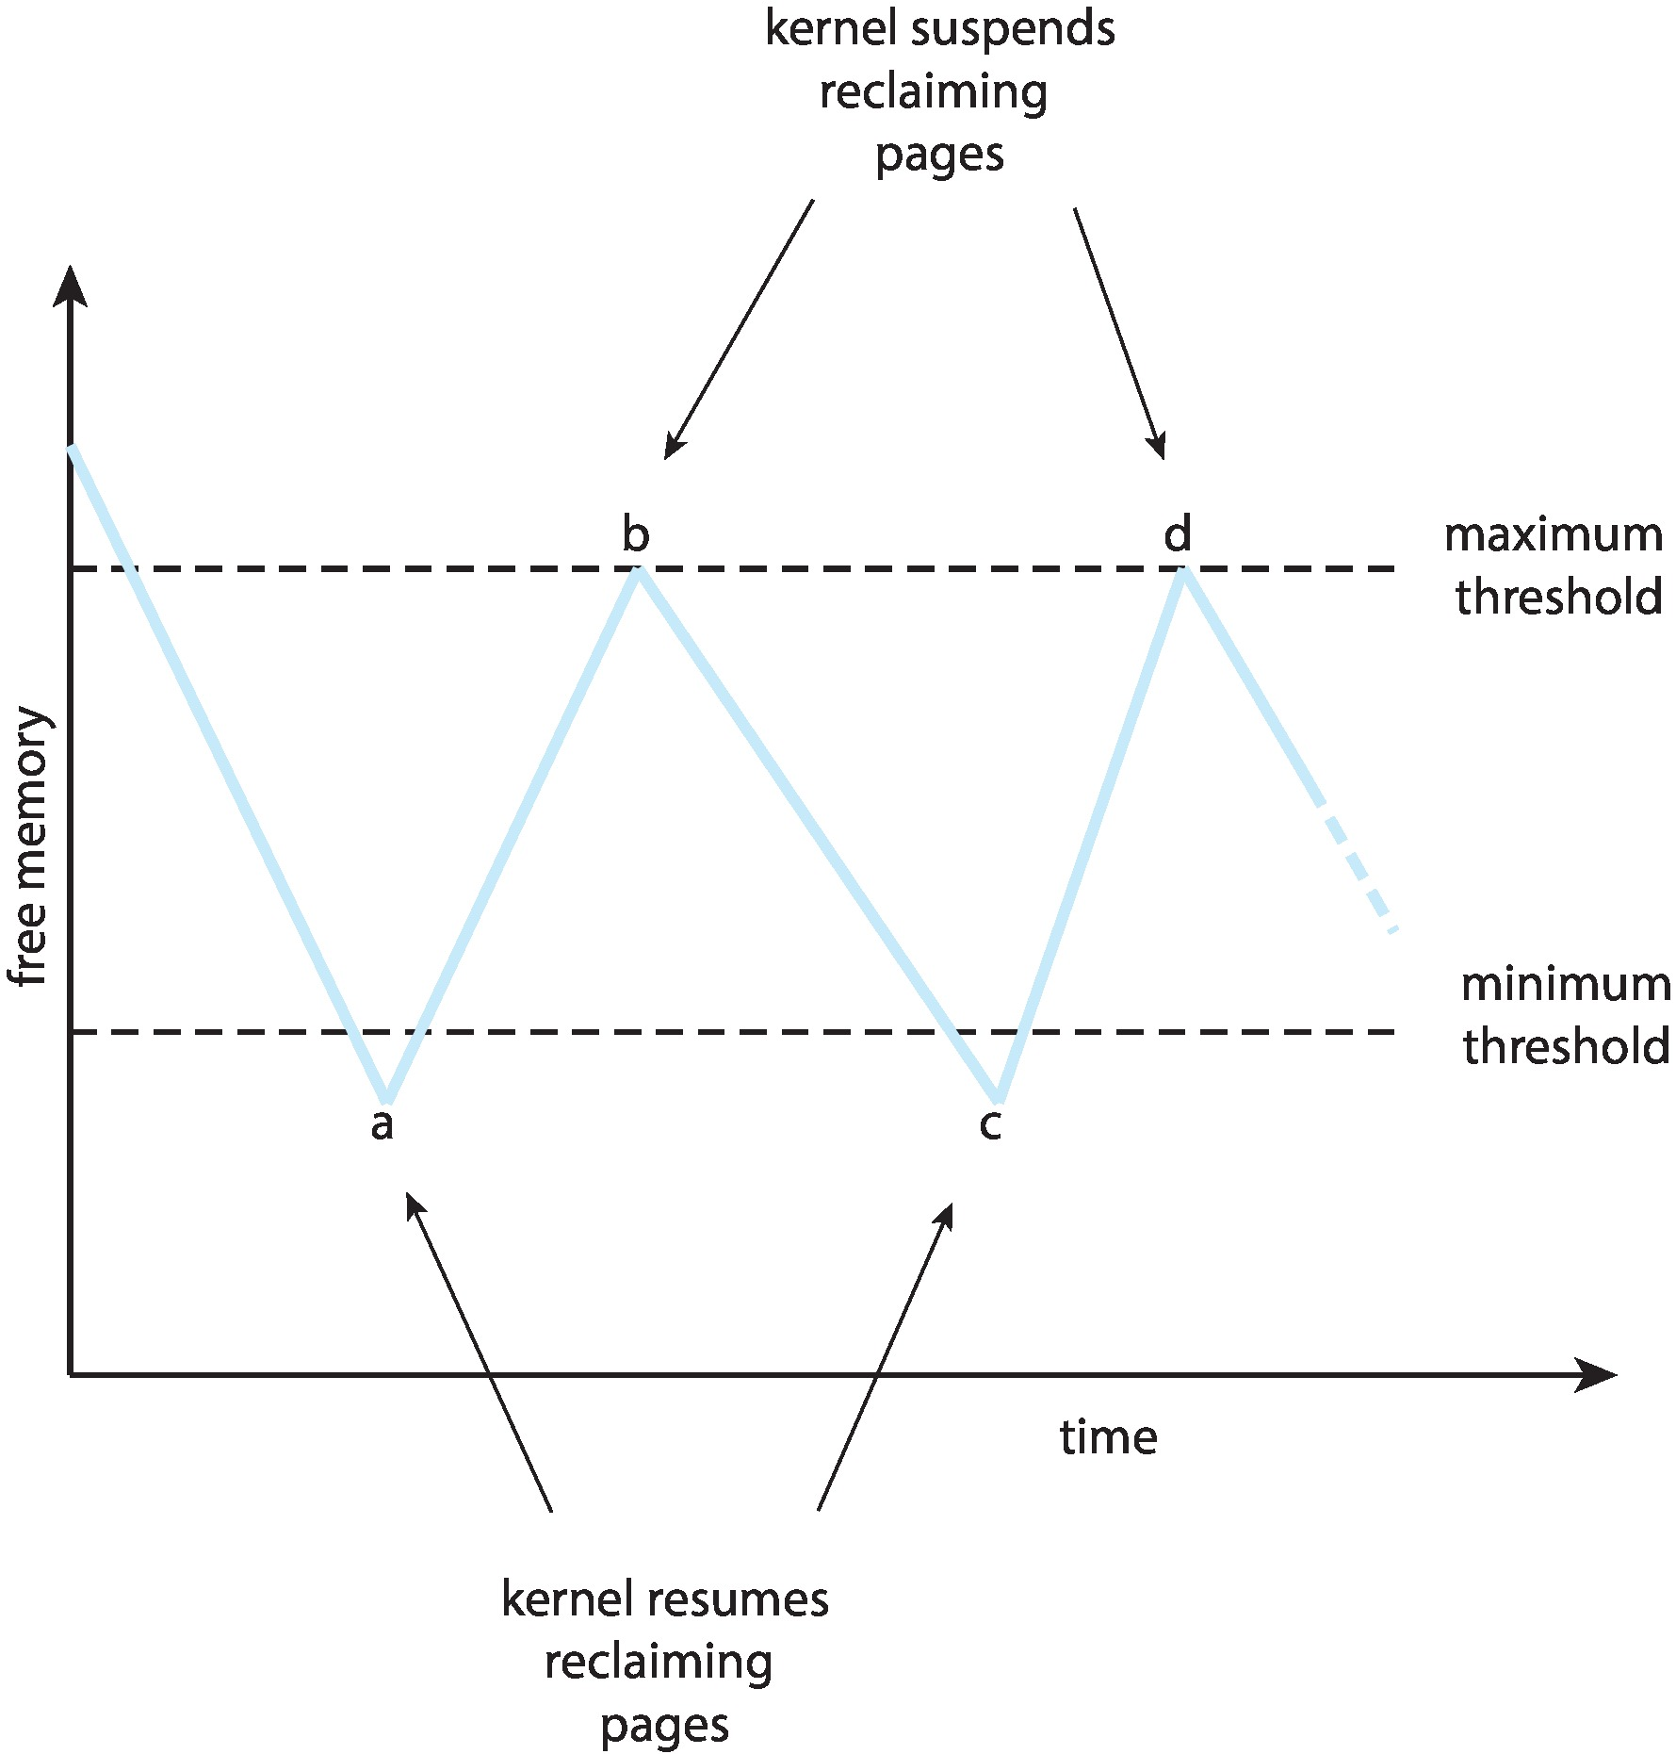
Reclaiming Pages Example

Slide 7
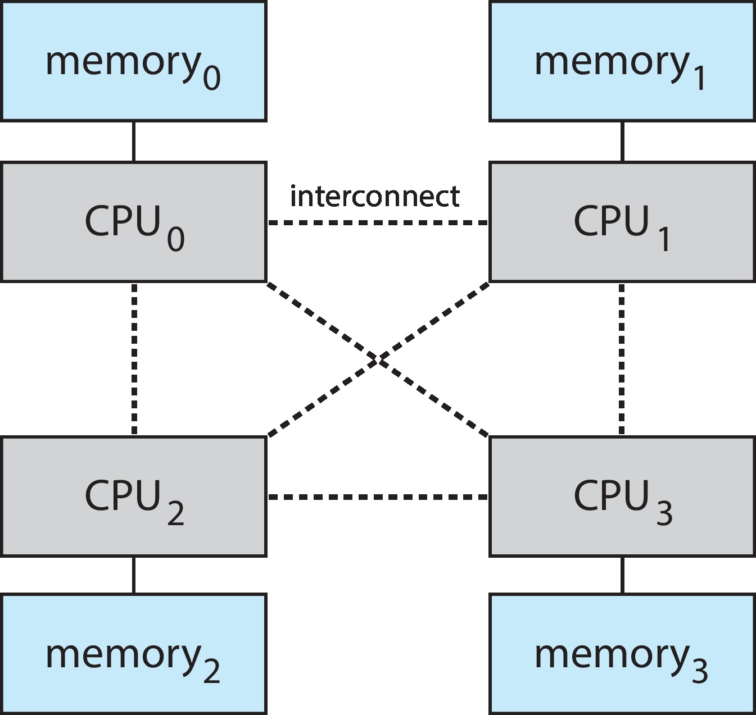
Non-Uniform Memory Access
So far all memory accessed equally
Many systems are NUMA – speed of access to memory varies
Consider system boards containing CPUs and memory, interconnected over a system bus
NUMA multiprocessing architecture

Slide 8
Non-Uniform Memory Access (Cont.)
Optimal performance comes from allocating memory “close to” the CPU on which the thread is scheduled
And modifying the scheduler to schedule the thread on the same system board when possible
Solved by Solaris by creating lgroups
Structure to track CPU / Memory low latency groups
Used my schedule and pager
When possible schedule all threads of a process and allocate all memory for that process within the lgroup

